Slide 1
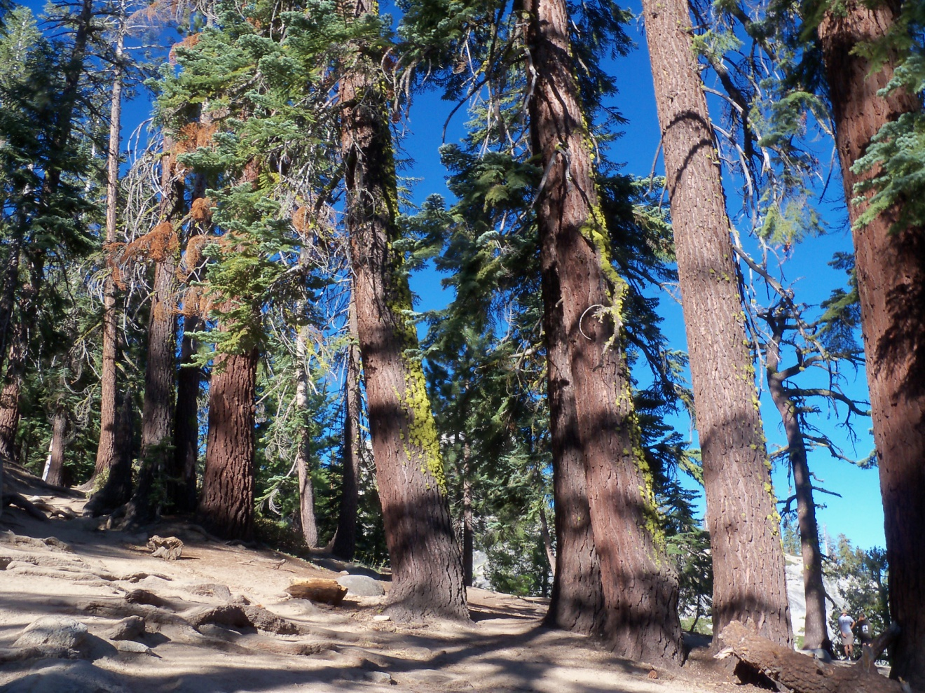

Remotely Detecting Tree Damage in Yosemite National Park
Presented by: Karla King
January 25, 2012
10:30 am
Liberal Arts Building Room 2114
Notes:
How many people have a basic understanding of remote sensing and its environmental applications?
General geographic information science ? The difference between raster vs vector
Point out different colored trees, you can see how energy would reflect off these vegetation types differently
And I know you all are excited to learn all about how to do this, but we will get to that a bit later

Slide 2
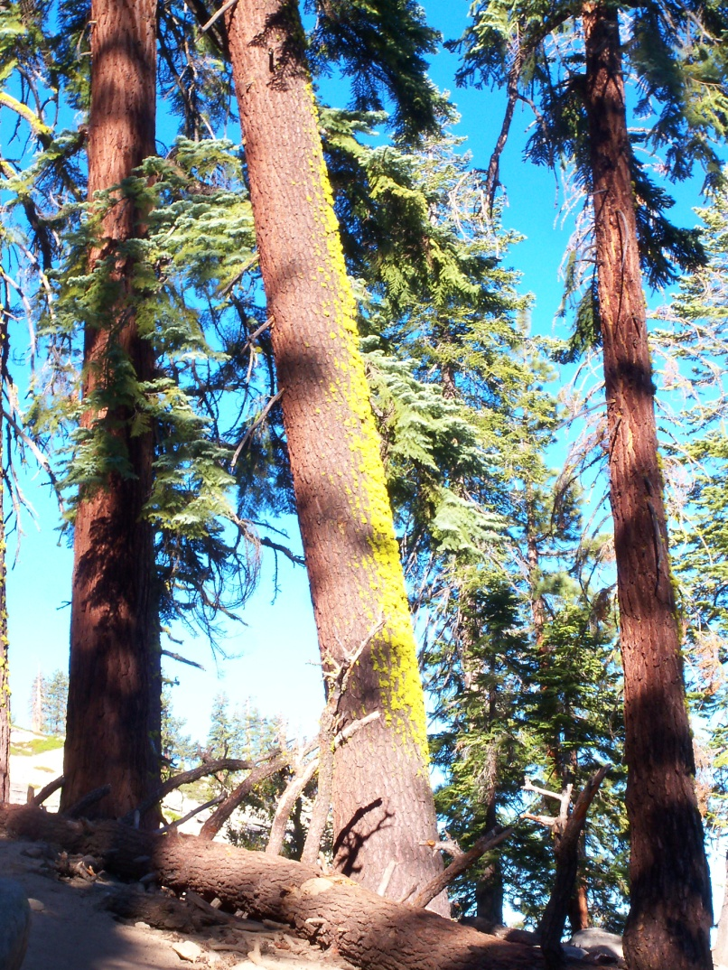
Overview
Problem statement
Area of study
Literature review
Hypothesis
Methodology
Cross correlation analysis
Image subtraction
Results
Discussion
Implications
Recommendations

Slide 3
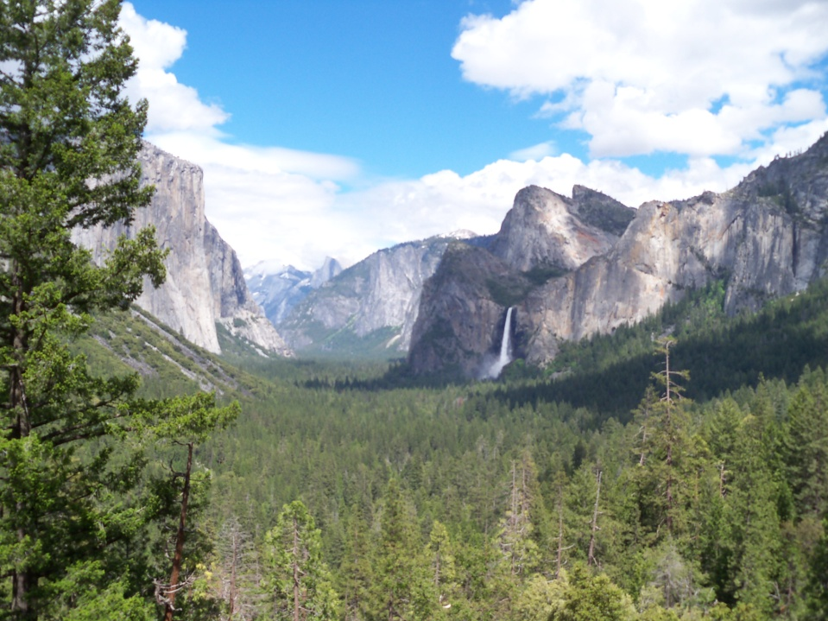
Statement of Problem
Damage due to insects and pathogens is the leading cause of disturbance in public forested land (USFS, 1994)
National Park Service Study:
Correlate fire occurrence with insect and pathogen outbreak
A need for accurate damage maps
Notes:
This research is
being developed to support a
region-wide study to correlate
fire occurrence with insect and pathogen outbreak
Need for accurate damge maps – that’s where I come in

Slide 4
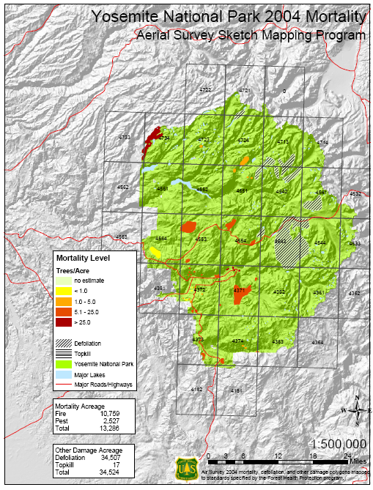
Statement of Problem
United States Forest Service conducts annual aerial surveys of the region
Since 1993
Crude
Inefficient
Source, U.S. Forest Service 2004
Notes:
And the forest service is already doing this
So, here we have a picture of the data they are producing – there is a need to have this data
Remote sensing presents an opportunity to gather this data

Slide 5
Area of Study

Slide 6
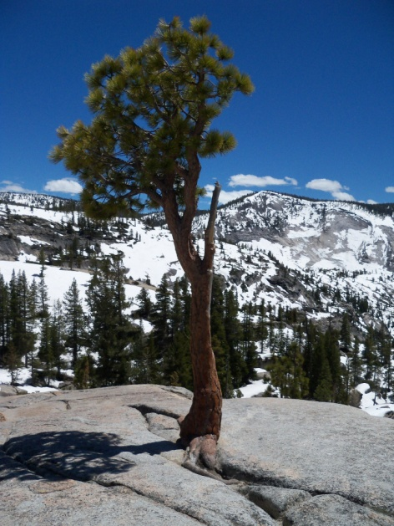
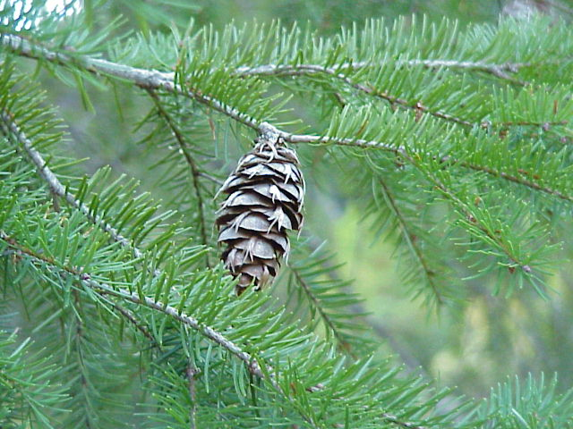
Host Tree Species
Top left: Jeffrey Pine
Bottom left: Douglas Fir (http://www.douglasfir.ca, 2011)
Notes:
Host tree species in the sierra nevadas

Slide 7
Literature Review
Remote sensing of defoliation
Plant responses to stress produce unique spectral “signatures”
Rock, Vogelmann & Williams (1986)
Ecological based studies
Mapping the succession patterns of forests after insect outbreak is possible
Kharuk, Ranson, Kuz’michev & Im (2003)
Change detection
The use of comparing two remotely sensed images to identify change can detect defoliation
Joria & Ahearn (1991); Muchoney & Haack (1994); Luther et al. (1997); Chalifoux et al. (1998); Radeloff et al. (1999)
Notes:
I broke it up into three main sections
defoliation
Plant responses to stress may have spectral “signatures” that could be used to map, monitor, and measure forest damage
Ecological studies
It provided evidence that mapping the succession patterns of forests after insect outbreak is possible.
2 Siberian study involving many similar tree species
Change
Many studies detecting insect defoliation compare two remotely sensed images to identify spectral variation from one year to another

Slide 8
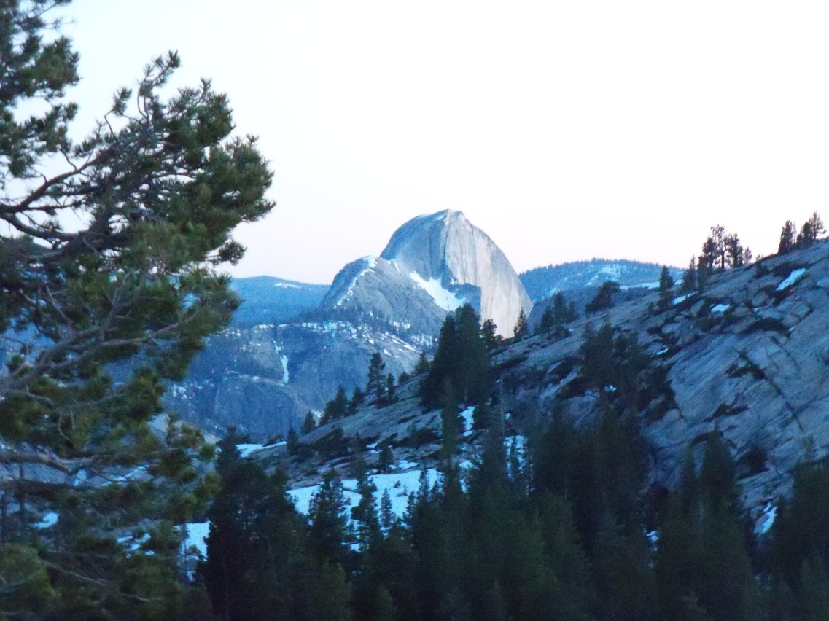
Hypothesis
A remotely sensed map and the USFS aerial survey map will have comparable accuracies.
A remotely sensed map will display forest damage in a pattern spatially and statistically similar to USFS aerial survey maps.
Notes:
Based on these following working hypothesis that will be statistically analyzed
A map created using remote sensing techniques will display forest damage in a pattern spatially and statistically similar to USFS aerial sketch survey maps.
The remotely sensed map displaying forest damage and the USFS aerial sketch survey map will have comparable accuracies.

Slide 9
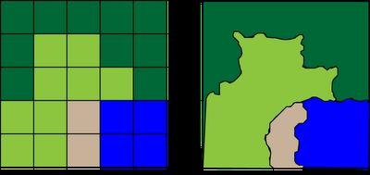
Raster vs. Vector
Raw Image
Feature Class
outsidetheneatline.blogspot.com, University of Connecticut

Slide 10
Data
Landsat 5 TM Imagery, August 2006
Landsat 5 TM Imagery, August 2011
glovis.usgs.gov
30 meter resolution, 7 bands
National Land Cover Dataset 2006
landcover.usgs.gov
20 classes
4. ) USFS Aerial Detection Surveys, 2006-2011
derived from manual aerial interpretation
available in .kmz format
Ancillary Data
USGS, 2011
Park Boundary File | USFS Fire History | Google Earth
Reformatting, Context | Accuracy Assessment | Accuracy Assessment
Notes:
(baseline) to be classified – comprised of forest cover to generate mean and standard deviation values (classess like barren land, forest, water)
Image to be processed (analyze change)
anniversery summer images
3) 2010 Yosemite National Park Mortality Map is available in .kmz format.
The images selected will be summer anniversary scenes captured in 2009 and 2010. Images should have 0% cloud cover.
A third central piece of data is the 2010 Yosemite National Park Mortality map created by the US Forest Service as part of their Aerial Sketch Survey Program. This data serves as the manual method of mapping mortality and defoliation to test the hypothesis that remote detection provides a method of mapping forest damage equal to manual methods. The 2010 Mortality Map is available on the USFS Region 5 website.

Slide 11
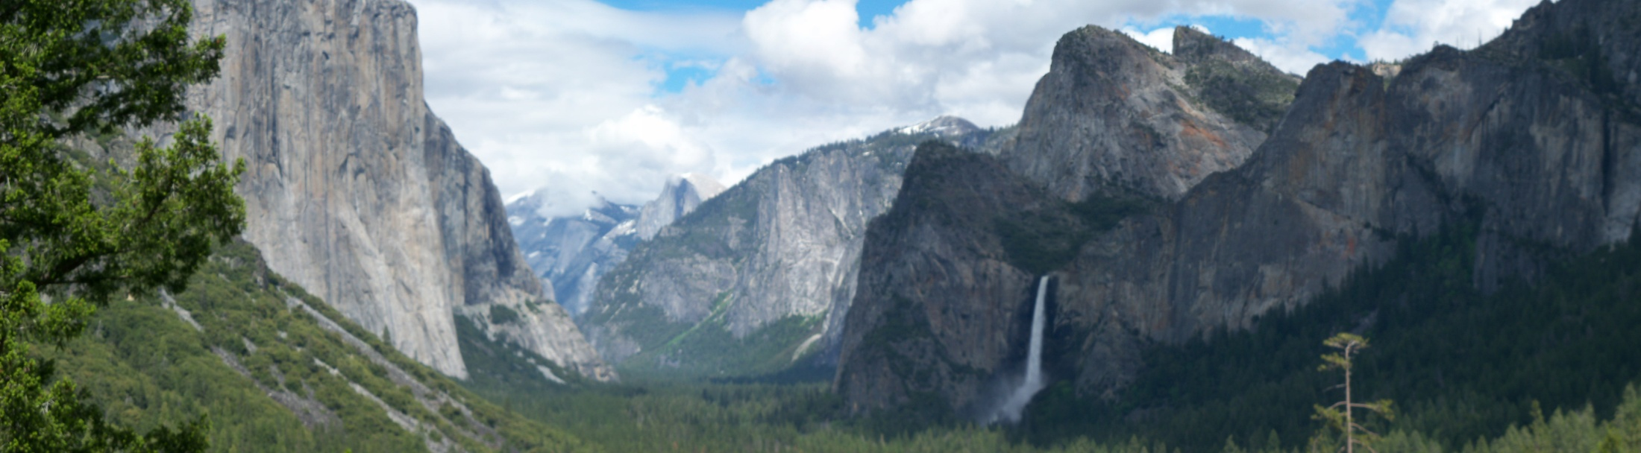
Data
Preprocessing
Tasseled Cap Transformation
Landsat imagery 2006 & 2011
Convert USFS Aerial detection survey to raster format & compile
Clip to park boundary
Landsat imagery 2006 & 2011, NLCD, USFS Aerial detection survey
Compile ground truth points

Slide 12
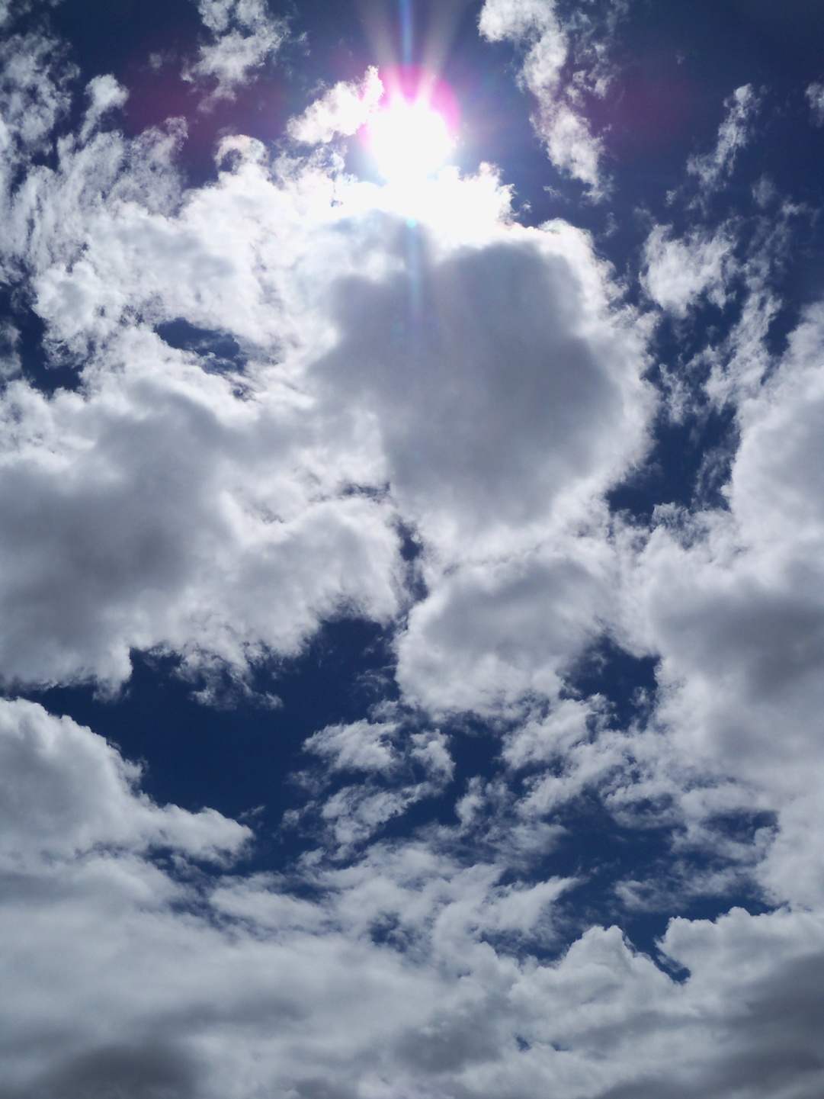
Methodology
Cross Correlation Analysis
Statistical analysis
Extract the Average and Population standard deviation values of 2011 image
Using NLCD 2006 class zones
Create images of attributes Mean and StandDev
Calculate a Z-score Image:
[Greenness] – [Mean]/ [StandDev]
Notes:
not supervised or unsupervised but a form of Statistical analysis,

Slide 13
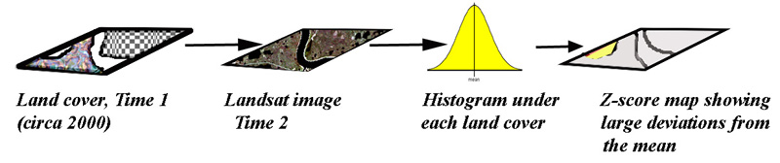
Methodology
Cross Correlation Analysis
(Source: Canada Centre for Remote Sensing)
Notes:
not supervised or unsupervised but a form of Statistical analysis,

Slide 14
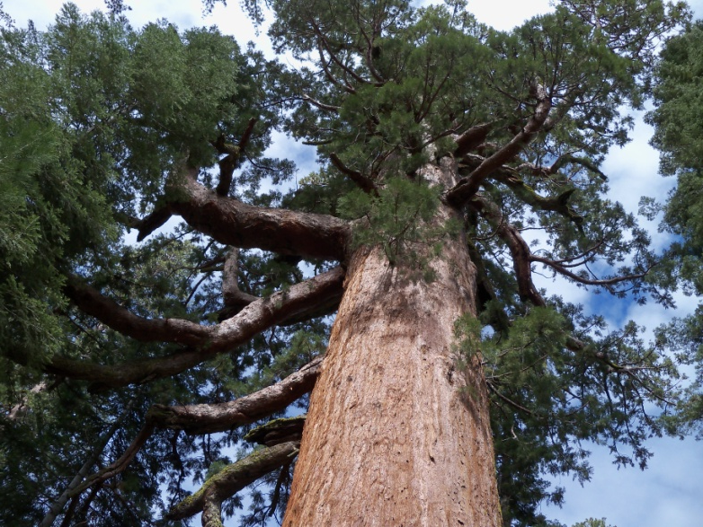
Methodology
Cross Correlation Analysis
Eight classes extracted & unique thresholds set
Range: -17 - 17
Land Cover | Damage Threshold
Open water | -13
Perennial water/ snow | -1.2
Urban | -2.74
Barren land | -4
Forest | -0.43
Shrub land | -6.87
Herbaceous | -1.89
Wetlands | -2.75
3 x 3 modal filter
Notes:
not supervised or unsupervised but a form of Statistical analysis,

Slide 15
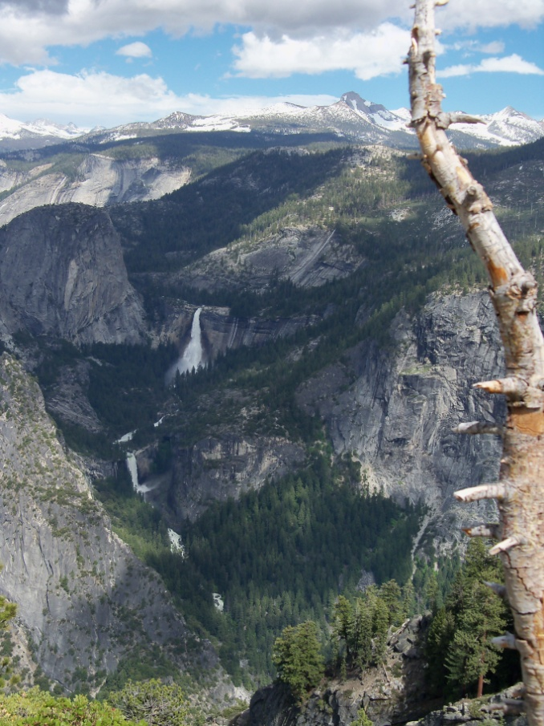
Methodology
Image Subtraction
2011 greenness component – 2006 greenness component
set threshold
-84.46 – 86.77
tolerance was set at -6.0
3 x 3 modal filter
Notes:
not supervised or unsupervised but a form of Statistical analysis,

Slide 16
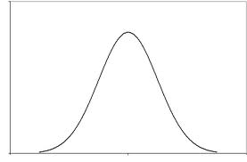
Data
Unique characteristics of data
Leaving values absolute allows the analyst to isolate damage
- x
Damage
+ x
Regrowth
1 | no damage
2 | damage
Notes:
Leaving values absolute allows the analyst to isolate damage and eliminate noise.

Slide 17
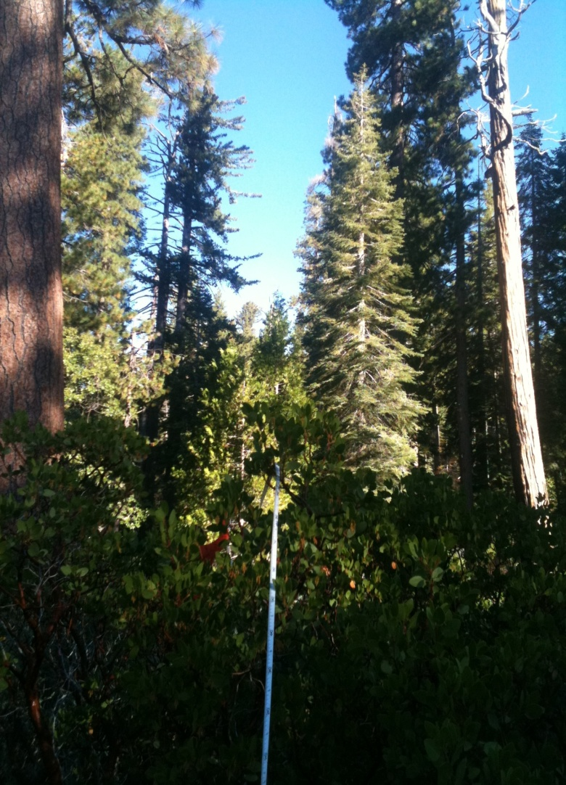
Data
Ground truth points
Source | Point count
Field observation | 13
USFS Fire History Data | 25
Random | 35
Stratified (map specific)* | 17
Total | 90
*Stratified over damage area

Slide 18
RESULTS

Slide 19
Statistical Analysis Hypothesis 1
A remotely sensed map and the USFS aerial survey map will have comparable accuracies.
USFS Aerial Survey map Remotely sensed map Accuracy Assessment Accuracy Assessment
Tasseled cap difference Accuracy Assessment
Compare Cohen’s kappa coefficient from accuracy assessment
Notes:
Closer to 1 wins

Slide 20
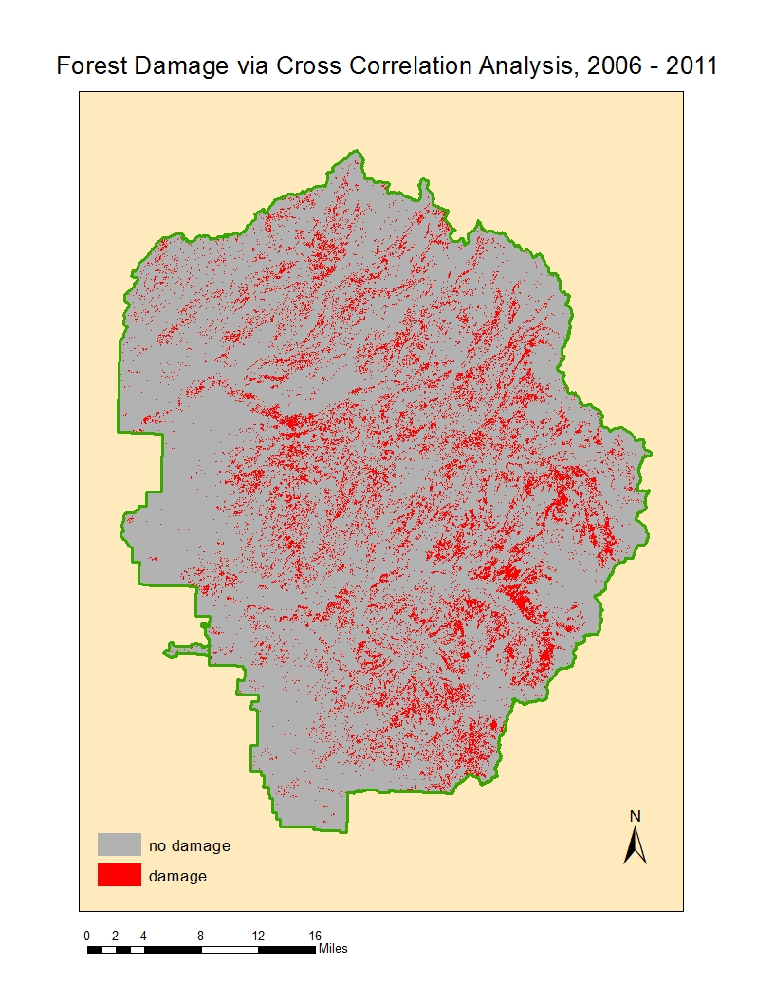

Slide 21
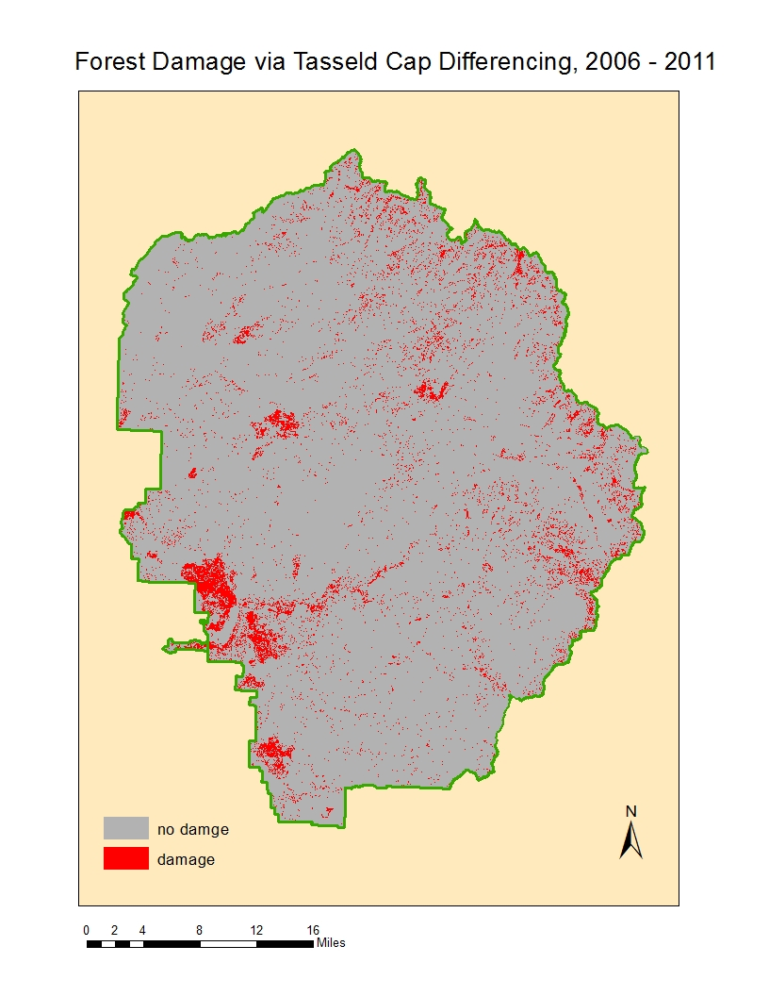

Slide 22
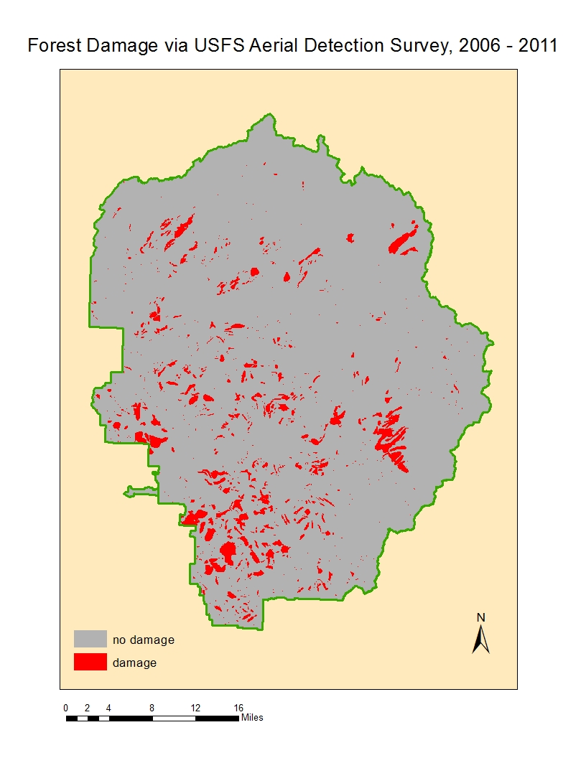

Slide 23
Accuracy Assessment
Cross correlation analysis
 | Observed
Predicted | 1 | 2 | sum
1 | 57 | 13 | 70
2 | 6 | 14 | 20
sum | 63 | 27 | 90
 | Damage Accuracy |  | 0.519
 |  | P(a) | 0.789
 |  | K | 0.556

Slide 24
Accuracy Assessment
Tasseled cap difference
 | Observed
Predicted | 1 | 2 | sum
1 | 60 | 10 | 70
2 | 6 | 14 | 20
sum | 66 | 24 | 90
 | Damage Accuracy |  | 0.583
 |  | P(a) | 0.822
 |  | K | 0.649

Slide 25
Accuracy Assessment
USFS Aerial Detection Survey
 | Observed
Predicted | 1 | 2 | sum
1 | 52 | 21 | 73
2 | 11 | 6 | 17
sum | 63 | 27 | 90
 | Damage Accuracy |  | 0.222
 |  | P(a) | 0.644
 |  | K | 0.491

Slide 26
Hypothesis Testing
A remotely sensed map and the USFS aerial survey map will have comparable accuracies.
0-.20 slight
.21–.40 fair
.41–.60 moderate
.61–.80 substantial
.81–1 near perfect
Cohen’s kappa according to Landis and Koch, 1977
Cross correlation analysis | .519
Tasseled cap difference | .649
USFS | .491
Accept

Slide 27
Statistical Analysis Hypothesis 2
A remotely sensed map will display forest damage in a pattern spatially and statistically similar to USFS aerial survey maps.
Spatially:
Scalar analysis
Qualitative
Statistically :
Cross tabulation
Cohen’s kappa coefficient
USFS Aerial Survey Map Map derived from remotely sensed Imagery
Notes:
Crosstab feature generates a contingency table comparing frequency of classes
Pixel by pixel basis
Spatially – if there is a pattern to the spatial distribution of disagreement, they can not be

Slide 28
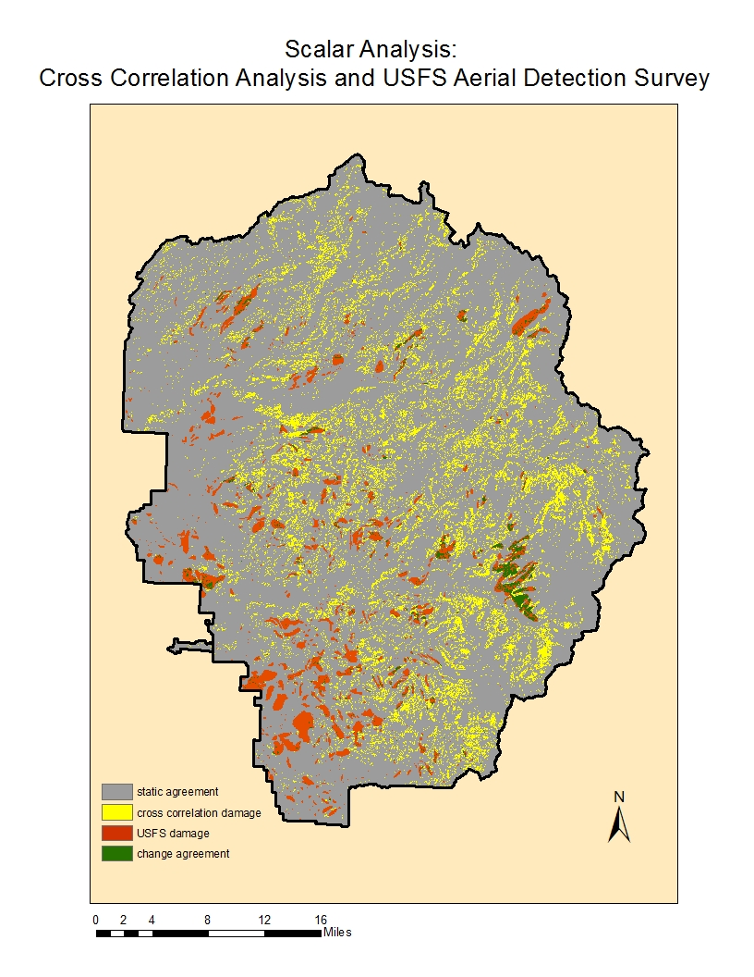

Slide 29
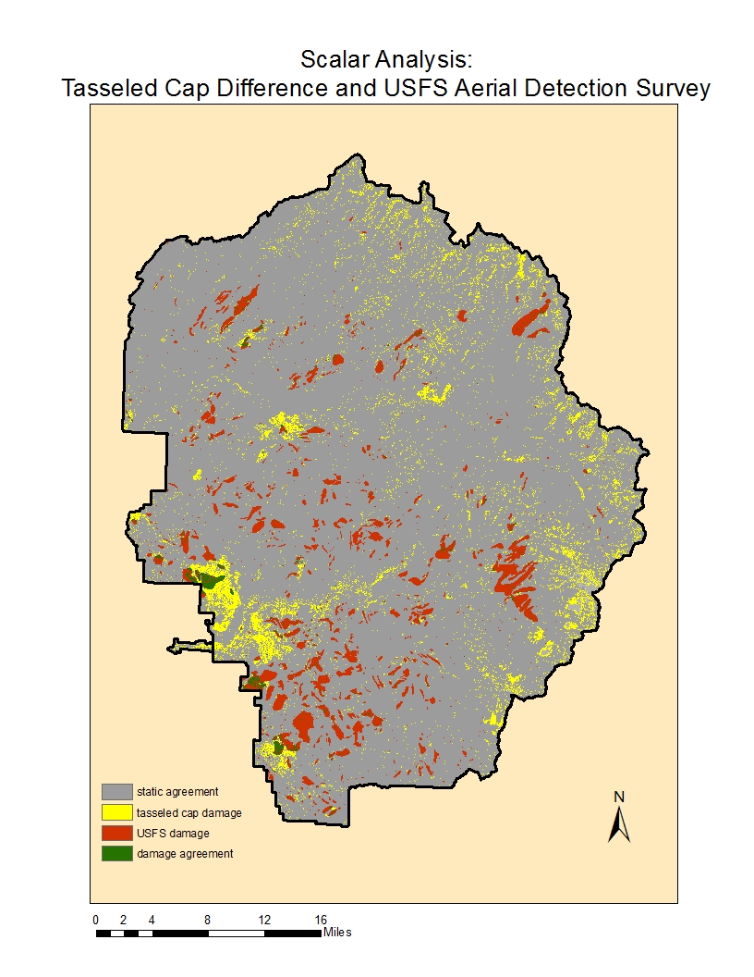

Slide 30
Cross Tabulation
 | Cross correlation analysis
USFS | 1 | 2 | Sum
1 | 2500074000 | 359214300 | 2859288300
2 | 146601000 | 24525900 | 171126900
sum | 2646675000 | 383740200 | 3030415200
Units - m²
 | Tasseled cap difference
USFS | 1 | 2 | sum
1 | 2670070500 | 179596800 | 2849667300
2 | 156815100 | 14357700 | 171172800
sum | 2826885600 | 193954500 | 3020840100
Units - m²

Slide 31
Statistical Analysis
Cohen’s kappa coefficient comparing
USFS Aerial Detection Survey to remote methods
 | Cross correlation analysis | Tasseled cap difference
P(a) | 0.833 | 0.889
P(e) | 0.007 | 0.886
Kappa | 0.011 | 0.019

Slide 32
Hypothesis Testing
2. A remotely sensed map will display forest damage in a pattern spatially and statistically similar to USFS aerial survey maps.
0-.20 slight
.21–.40 fair
.41–.60 moderate
.61–.80 substantial
.81–1 near perfect
Landis and Koch, 1977
Cross correlation analysis | .011
Tasseled cap difference | .019
Reject

Slide 33
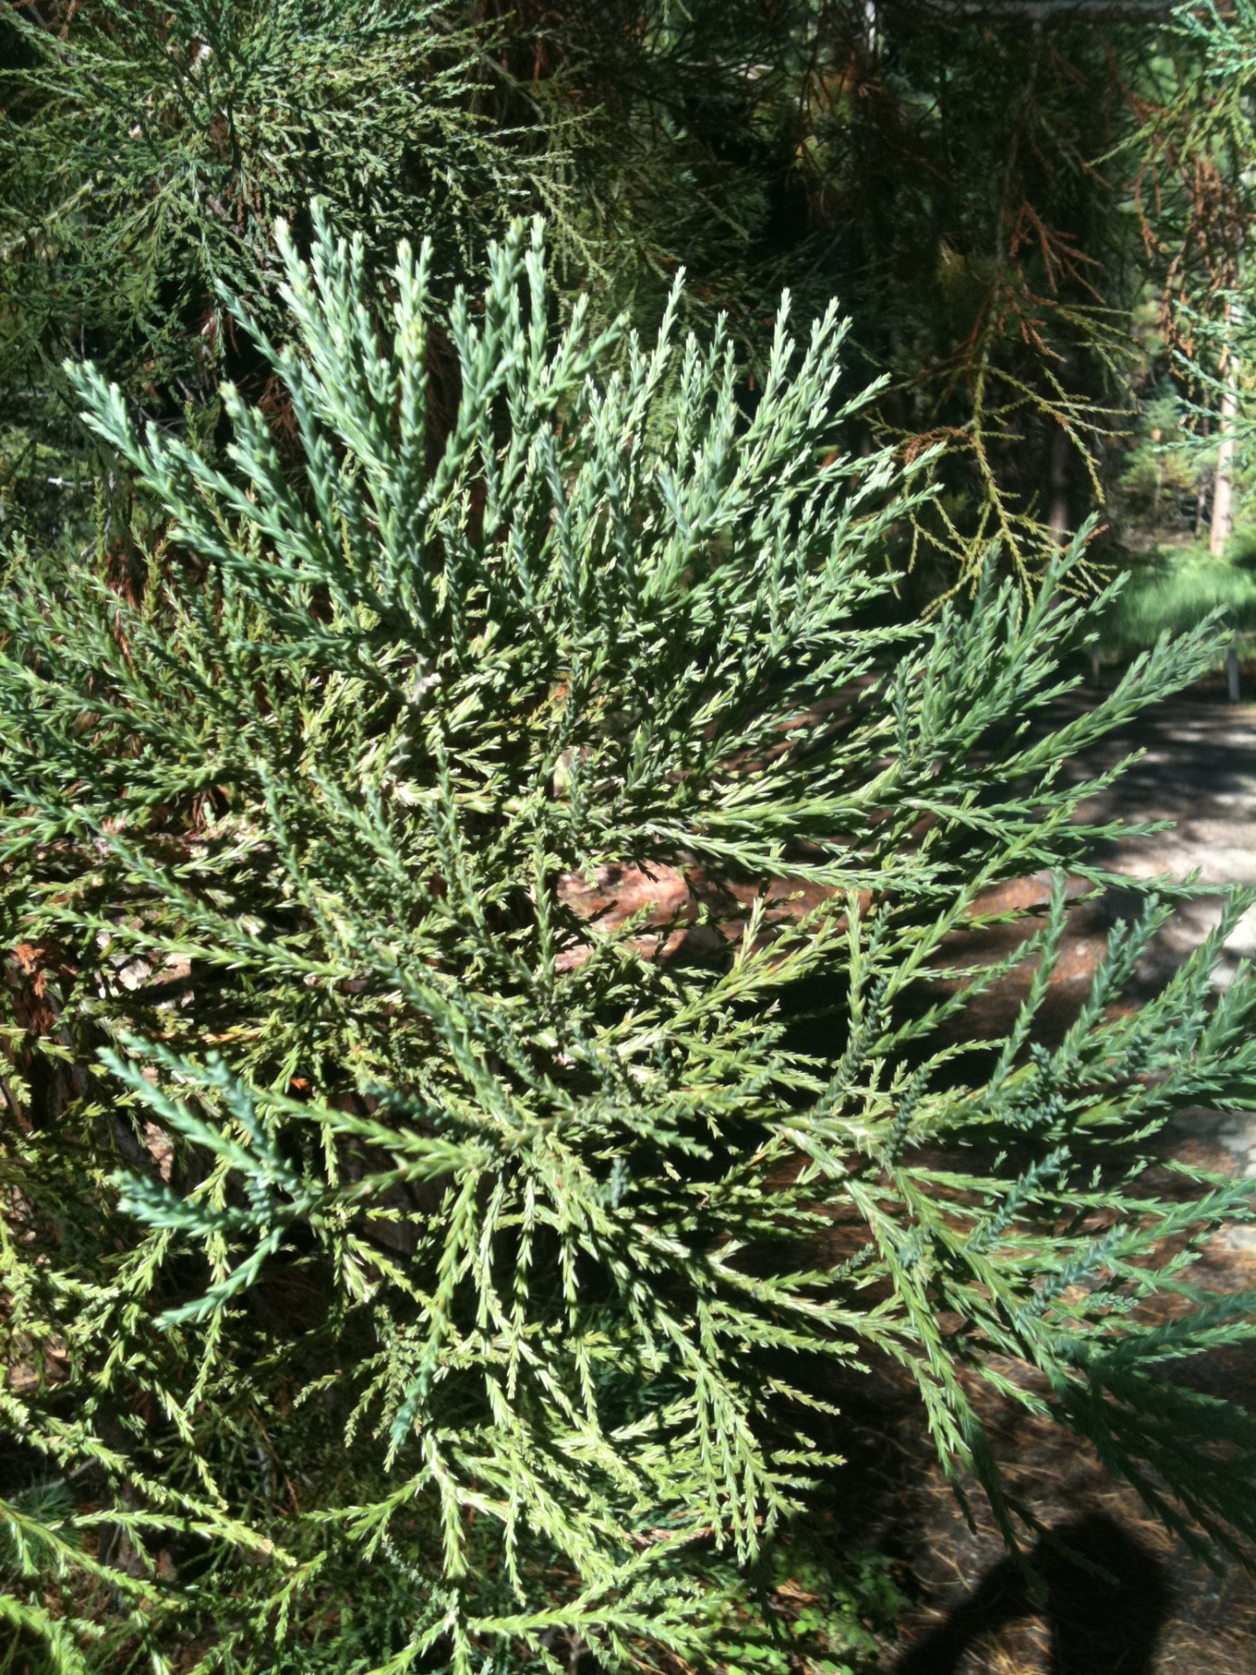
Discussion
The remote sensing methods had accuracies exceeding that of the manual method
Less significant to reject second hypothesis
Tasseled cap difference method outperformed in all tests
USFS Aerial Detection Survey appears to map general areas of forest degradation quite well, however, is not very precise.
Remote sensing techniques exhibited type I errors
Fluctuations in seasonal and natural environmental conditions.
Cross correlation analysis may be more sensitive
Notes:
The remote sensing methods had accuracies exceeding that of the manual method & displayed little to no spatial and statistical similarity to the manual method
Less significant to reject second hypothesisThe fact that we were able to accept the first hypothesis as true, demonstrating a low accuracy of the manual method, makes the second hypothesis of creating a map similar to the manual method less significant. Therefore, the implications of rejecting the second hypothesis are less adverse.
Tasseled cap difference method outperformed in over all accuracy, damage accuracy and displayed more similarity to the manual method
Qualitatively, it should be noted that the USFS Aerial Detection Survey appears to map general areas of forest degradation quite well, however, is not very precise. Accuracy assessment’s conducted in the field of remote sensing favor highly precise results given the (30 meter) pixel by pixel basis for analysis. For example, a test point identified as “damaged” may appear one pixel to the right of an entire polygon denoted as change. The method calls this an error, allowing very little room for geo-registration inaccuracies.
The remote sensing techniques tested exhibited type I errors in a particular pattern that is cause for concern. Type I errors are those instances where damage is predicted but not observed. Fluctuations in seasonal and natural environmental conditions are inherent in remote sensing methods. Areas of high elevation are more likely to have these variations present due to sheer rock exposure and snow and snow melt variations from year to year. Areas of high elevation are therefore more susceptible to display change when it has not occurred. This phenomenon was evidenced in both the cross correlation analysis and tasseled cap difference techniques’ final products. A large majority of type I errors were located in the mountainous regions of the Park. Normalizing for this phenomenon would further enhance the remote sensing techniques. The cross correlation analysis had an anomalous amount of damage detected in the higher elevation regions of the Park. This is particularly evident in Figure 13, displaying a great amount of damage where the USFS Aerial Detection Survey did not. The cross correlation analysis may be more sensitive to seasonal variations as discussed above. Another hypothesis holds that the cross correlation analysis method is truly capturing some small environmental change in phenology not readily detectable through other methods or viewed by the eye. This is a viable explanation because high elevation ecosystems are the first to demonstrate the impacts of climate change.

Slide 34
Implications
This study offers a means to eliminate the cost and labor associated with the manually derived maps
Minimal data requirements and ease of processing -> may be applied widely
Notes:
The remote sensing methods had accuracies exceeding that of the manual method & displayed little to no spatial and statistical similarity to the manual method
Less significant to reject second hypothesisThe fact that we were able to accept the first hypothesis as true, demonstrating a low accuracy of the manual method, makes the second hypothesis of creating a map similar to the manual method less significant. Therefore, the implications of rejecting the second hypothesis are less adverse.
Tasseled cap difference method outperformed in over all accuracy, damage accuracy and displayed more similarity to the manual method
Qualitatively, it should be noted that the USFS Aerial Detection Survey appears to map general areas of forest degradation quite well, however, is not very precise. Accuracy assessment’s conducted in the field of remote sensing favor highly precise results given the (30 meter) pixel by pixel basis for analysis. For example, a test point identified as “damaged” may appear one pixel to the right of an entire polygon denoted as change. The method calls this an error, allowing very little room for geo-registration inaccuracies.
The remote sensing techniques tested exhibited type I errors in a particular pattern that is cause for concern. Type I errors are those instances where damage is predicted but not observed. Fluctuations in seasonal and natural environmental conditions are inherent in remote sensing methods. Areas of high elevation are more likely to have these variations present due to sheer rock exposure and snow and snow melt variations from year to year. Areas of high elevation are therefore more susceptible to display change when it has not occurred. This phenomenon was evidenced in both the cross correlation analysis and tasseled cap difference techniques’ final products. A large majority of type I errors were located in the mountainous regions of the Park. Normalizing for this phenomenon would further enhance the remote sensing techniques. The cross correlation analysis had an anomalous amount of damage detected in the higher elevation regions of the Park. This is particularly evident in Figure 13, displaying a great amount of damage where the USFS Aerial Detection Survey did not. The cross correlation analysis may be more sensitive to seasonal variations as discussed above. Another hypothesis holds that the cross correlation analysis method is truly capturing some small environmental change in phenology not readily detectable through other methods or viewed by the eye. This is a viable explanation because high elevation ecosystems are the first to demonstrate the impacts of climate change.

Slide 35
Recommendations for Further Study
Enhanced forms of topographic correction
Teillet-C correction outlined by Meyer et al., (1993)
Adjusting thresholds
Manipulate the accuracy assessment method
Notes:
The remote sensing methods had accuracies exceeding that of the manual method & displayed little to no spatial and statistical similarity to the manual method
Less significant to reject second hypothesisThe fact that we were able to accept the first hypothesis as true, demonstrating a low accuracy of the manual method, makes the second hypothesis of creating a map similar to the manual method less significant. Therefore, the implications of rejecting the second hypothesis are less adverse.
Tasseled cap difference method outperformed in over all accuracy, damage accuracy and displayed more similarity to the manual method
Qualitatively, it should be noted that the USFS Aerial Detection Survey appears to map general areas of forest degradation quite well, however, is not very precise. Accuracy assessment’s conducted in the field of remote sensing favor highly precise results given the (30 meter) pixel by pixel basis for analysis. For example, a test point identified as “damaged” may appear one pixel to the right of an entire polygon denoted as change. The method calls this an error, allowing very little room for geo-registration inaccuracies.
The remote sensing techniques tested exhibited type I errors in a particular pattern that is cause for concern. Type I errors are those instances where damage is predicted but not observed. Fluctuations in seasonal and natural environmental conditions are inherent in remote sensing methods. Areas of high elevation are more likely to have these variations present due to sheer rock exposure and snow and snow melt variations from year to year. Areas of high elevation are therefore more susceptible to display change when it has not occurred. This phenomenon was evidenced in both the cross correlation analysis and tasseled cap difference techniques’ final products. A large majority of type I errors were located in the mountainous regions of the Park. Normalizing for this phenomenon would further enhance the remote sensing techniques. The cross correlation analysis had an anomalous amount of damage detected in the higher elevation regions of the Park. This is particularly evident in Figure 13, displaying a great amount of damage where the USFS Aerial Detection Survey did not. The cross correlation analysis may be more sensitive to seasonal variations as discussed above. Another hypothesis holds that the cross correlation analysis method is truly capturing some small environmental change in phenology not readily detectable through other methods or viewed by the eye. This is a viable explanation because high elevation ecosystems are the first to demonstrate the impacts of climate change.

Slide 36
References
Bré da, Nathalie J. J. “Ground based measurements of leaf area index; A review of methods, instruments and current controversies.” Perspectives in Experimental Biology 54, no. 392(2003): 2403-2417.
Campbell, James P. Introduction to Remote Sensing: Fourth Edition. New York, London: The Guilford Press, 2002.
Canada Centre for Remote Sensing . “Mapping land cover change and terrestrial dynamics over northern Canada using multi-temporal Landsat imagery.” Paper presented at a meeting, 2005.
Chalifoux, S., Cavayas, F. & Gray, J. T. “Map-guided approach for the automatic detection on Landsat TM images of forest stands damaged by the spruce budworm.” Photogrammetric Engineering and Remote Sensing 64(1998): 629−635.
Cohen, Warren B. and Samuel N. Goward.“Landsat’s Role in Ecological Applications in Remote Sensing.” Bioscience 54 no. 6 (2004): 535-545.
Curran, P.J. “Multispectral remote sensing for the estimation of green leaf area index.” The Royal Society 309 (1983): 257 – 270.
Davey, C. A., K. T. Redmond and D. B. Simeral. Weather and climate inventory National Park Service Sierra Nevada Network. A report prepared by the Western Regional Climate Center, Desert Research Institute. Reno, NV: 2007
de Beurs, K.M. and P.A. Towsend. “Estimating the effect of gypsy moth defoliation using MODIS.” Remote Sensing of the Environment 112 (2008): 3983–3990.
Fassnacht, Karin S., Stith T. Gower, Mark D. MacKenzie, Erik V. Nordheim and Thomas M. Lillesand “Estimating the leaf area index of North Central Wisconsin forests using the Landsat thematic mapper.” Remote Sensing of Environment 61 (1997):229-245.
Fraser, R.H. “Mapping insect-induced tree defoliation and mortality using coarse spatial resolution imagery.” International Journal of Remote Sensing 26 (2005) 193−200.
Hagle, S., S. Kegley and S. Williams. “Assessing pathogen and insect succession function in forest ecosystems.” Report prepared by the US Department of Agriculture, US Forest Service, 1995.

Slide 37
References
Joria, P. E., and S. C. Ahearn. “A comparison of the SPOT and Landsat Thematic Mapper satellite systems for detecting gypsy moth defoliation in Michigan.” Photogrammetric Engineering & Remote Sensing 57 (1995): 1605−1612.
Kelly, M., D. Shaari, Q.Guo, and D. Liu. “A Comparison of Standard and Hybrid Classifier Methods for MappingHardwood Mortality in Areas Affected by Sudden Oak Death.” Photogrammetric Engineering & Remote Sensing 70 no.11 (2004): 1229–1239.
Kharuk, V.I., K.J. Ranson, V.V. Kuz’michev, and S.T. Im. “Landsat-based analysis of insect outbreaks in southern Siberia. Remote Sensing.” Remote Sensing 29 no. 2 (2003): 286-297
Koeln, Greagory and Jeana Bissonnette. “Cross- Correlation Analysis: Mapping Land cover changes with a historic Land cover database and a recent, single-date, multi-spectral image.” Paper presented by the Earth Satellite Corporation.
Lee, S.H. and H.K. Cho. “Detection of the pine trees damaged by pine wilt disease using high spatial remote sensing data.” Korea Forest Research Institute, Remote Sensing Laboratory, Seoul (2006): 130-712.
Luther, J. E., S. E. Franklin, J. Judak and J.P. Meades. “Forecasting the susceptibility and vulnerability of balsam ﬁn stands to insect defoliation with Landsat Thematic Mapper data.” Remote Sensing of Environment 59 (1997): 77−91.
Macomber, S. and C. Woodcock. "Mapping and monitoring conifer mortality using remote sensing in the Lake Tahoe Basin." Remote Sensing of Environment 50 no. 3 (1994): 255-266.
Muchoney, D. M. and B.N. Haack. “Change detection for monitoring forest defoliation.” Photogrammetric Engineering & Remote Sensing 60 (1994): 1243−1251.
National Ocean and Atmospheric Administration What is NDVI? http://www.csc.noaa.gov/crs/definitions/NDVI.html (accessed January 28, 2011)
National Park Service Sierra Nevada Network: Monitoring and inventory Program, http://science.nature.nps.gov/im/units/sien/index.cfm (accessed 15 November 2010)

Slide 38
References
Riley, J. R. “Remote Sensing in Entomology.” Annual Review of Entomology 34 (1989): 247-71.
Rock, B.N., J.E. Vogelmann and D.L. Williams. “Remote Detection of Forest Damage.” BioScience (1986) 439.
US Forest Service Aerial Detection Surveys http://www.fs.fed.us/r5/spf/fhp/fhm/aerial/: (accessed 25 October 2010)
US Forest Service Remote Sensing Techniques for Rapid Assessment of Forest Damage Caused by Catastrophic Climatic Events, 2001.
US Forest Service California forest health, Pacific Southwest Region, Forest Pest Management, 1994.
US Geologic Survey, Landsat Project Description http://landsat.usgs.gov/about_landsat5.php: (accessed 14 February 2011)
Wickman, B. E. “Forest health in the Blue Mountains: the influence of insects and diseases.” A report prepared by the US Forest Service, Pacific Northwest Research Station, Portland, Oregon, 1992

Slide 39
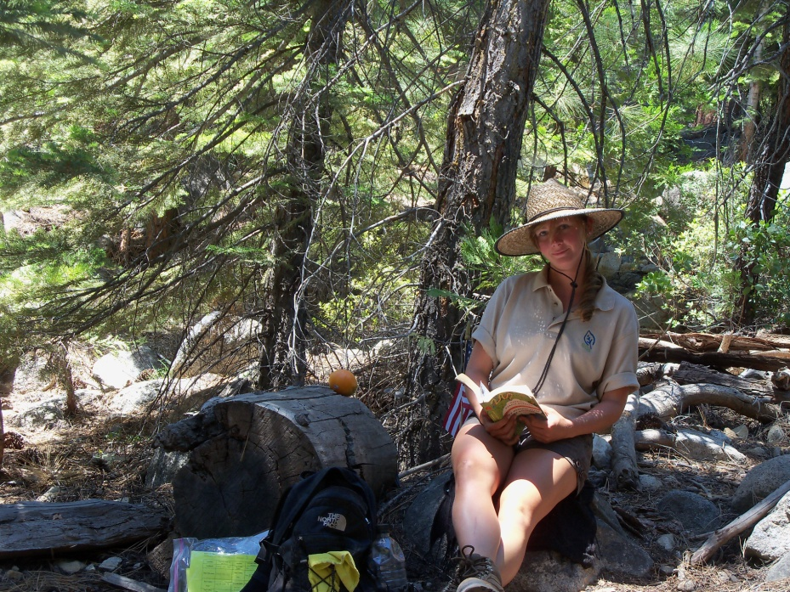
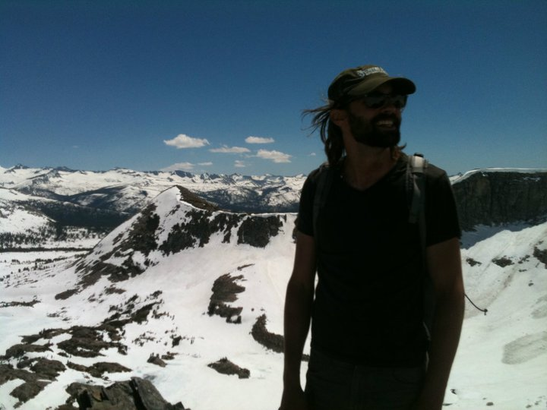
Thank you
Advisers
Friends & family
Robert Heilmayer & Matt Nolte
Towson University

